Slide 1
Welcome to Coding week!
Be Leaders, co facilitators
Be determined
Be diverse
Show teamwork!

Slide 2
Be respectful
Be on task
Everything is recorded!

Slide 3
Vocabulary check in! Raise your hand to share what you know about these terms:
Distance:
Time:
Rate:

Slide 4
Distance, Rate and Time in Tables
A police car drives 236 km in 3 hours.
What is its average speed in kilometers per hour?
Time always on the left
Distance always on the right
Hours | Kilometers
3 | 236
y ÷ x = COP
distance ÷ time = rate
Rate / COP / Speed in the middle

Slide 5
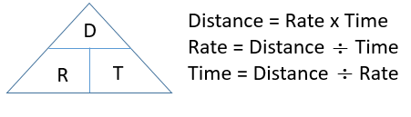
Distance, Rate and Time in College

Slide 6

Computing Rates
#1 Assignment: understanding rates
Solve the problems in #1 using tables or rules
Start #2 if you finish early
Hours | Kilometers
3 | 236
•78.6
Notes:
Change directions to finding the constant or the rate for each situation
Add title or units to answer

Slide 7
Coding groups
Assign student groups.
Group 1: Group 2: Group 3: Group 4:
Notes:
Andre
Brooklyn
Isaac
Jessica
Angel

Slide 8
Computing Rates
Check #1 with your team!

Slide 9
Computing Rates
With your team
Solve the problems in #2-3 using tables or rules
Complete #4 if finished early
Time | Distance
3 | 236
•78.6
Notes:
Change directions to finding the constant or the rate for each situation
Add title or units to answer

Slide 10
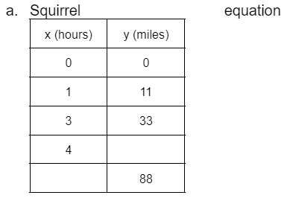
New Handout!
Complete the tables
Write equations y = COP•x
Graph

Slide 11
Check with your team!

Slide 12
Diverse Story!

Slide 13
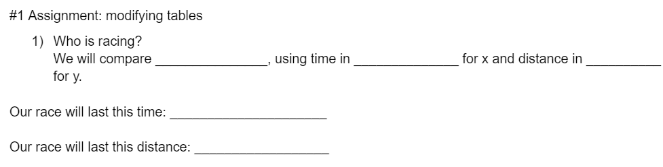

Slide 14
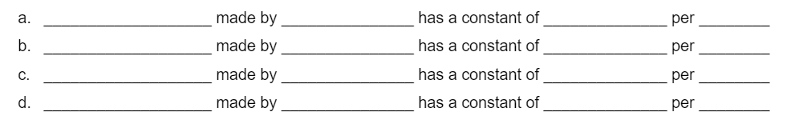

Slide 15
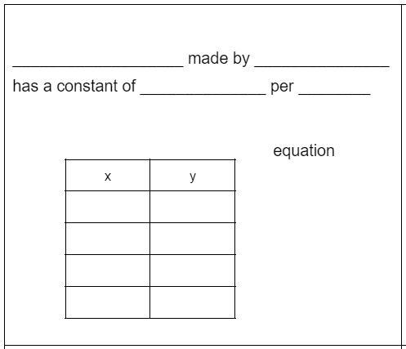

Slide 16
